Slide 1
Customer Based Recommendation
A similarity based approach

Slide 2
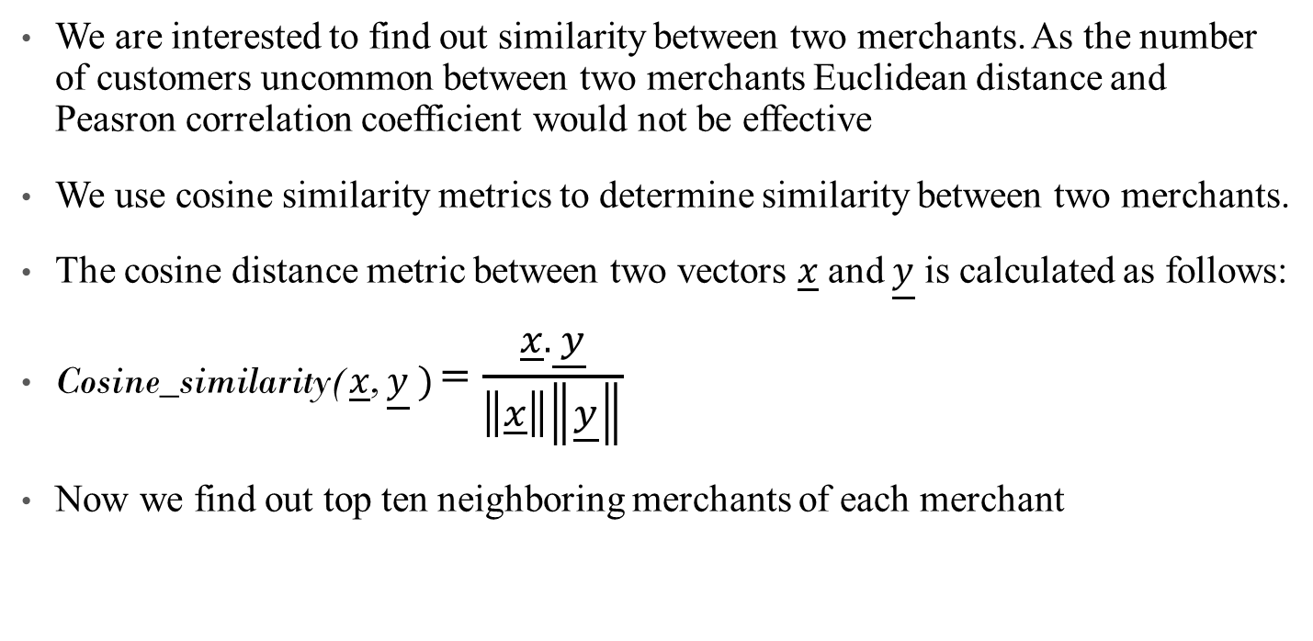
Cosine Similarity
We are interested to find out similarity between two merchants. As the number of customers uncommon between two merchants Euclidean distance and Peasron correlation coefficient would not be effective
We use cosine similarity metrics to determine similarity between two merchants.
The cosine distance metric between two vectors $\underline{x}$and $\underline{y}$ is calculated as follows:
Cosine_similarity($\underline{x}$, $\underline{y} )$= $\frac{\underline{x}.\underline{ y}}{\left\|\underline{x}\right\|\left\|\underline{y}\right\|}$
Now we find out top ten neighboring merchants of each merchant

Slide 3
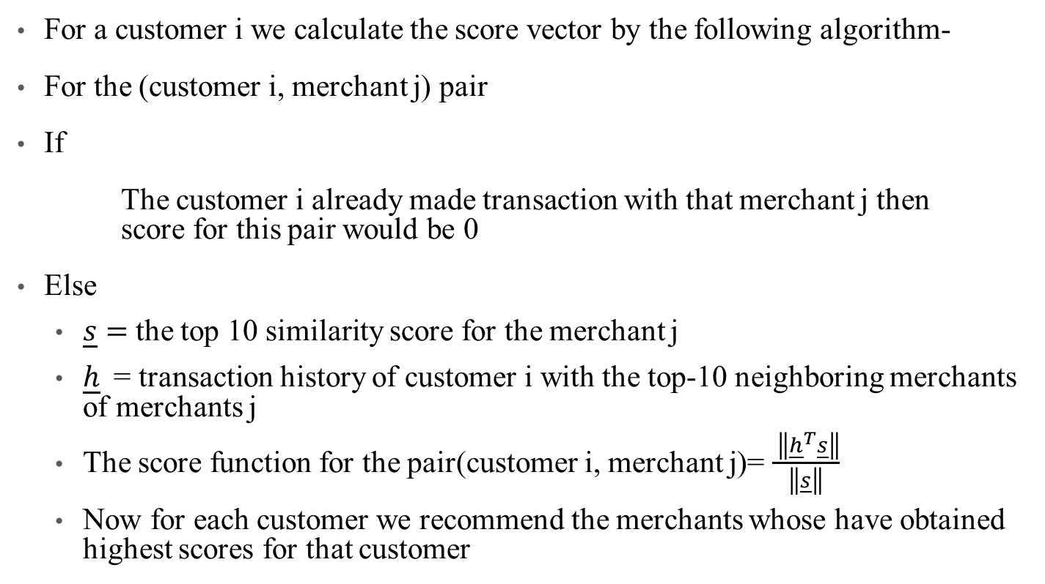
Generating Score function for each customer
For a customer i we calculate the score vector by the following algorithm-
For the (customer i, merchant j) pair
If
The customer i already made transaction with that merchant j then score for this pair would be 0
Else
$\underline{s}=$the top 10 similarity score for the merchant j
$\underline{h}$= transaction history of customer i with the top-10 neighboring merchants of merchants j
The score function for the pair(customer i, merchant j)= $\frac{ \left\|{\underline{h}}^{T}\underline{s}\right\|}{\left\|\underline{s}\right\|}$
Now for each customer we recommend the merchants whose have obtained highest scores for that customer

Slide 4

IRLBA

Slide 5
What is IRLBA?
The Implicitly Restarted Lanczos bidiagonalization algorithm (IRLBA) of Jim Baglama and Lothar Reichel is a state of the art method for computing a few singular vectors and corresponding singular values of huge matrices.
With it, computation of partial SVDs and principal component analyses of very large scale data is very time and space -efficient. The package works well with sparse matrices.

Slide 6
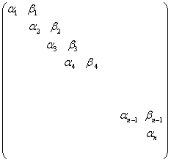
SVD and IRLBA
The singular value decomposition (SVD) of an m×n c matrix A can be written as A = UΣV^{T}
For Lanczos Bidiagonalization we consider a trimmed version
A = P_{n}B_{n}Q_{n}^{T}
Here B_{n} will of the special form:
Notes:
where the zero rows of the bidiagonal matrix have been removed and, therefore, Pn is now an m × n matrix with orthonormal columns, Qn is a unitary matrix of order n, and Bn is the

Slide 7
Bidiagonalization Algorithm
Expressions can be written in vector form by equating the jth column
Aq_{j} = β_{j-1} p_{j−1} + α_{j}p_{j},
A^{T}p_{j} = α_{j}q_{j} + β_{j}q_{j+1}.
From This we can obtain the recursive relation:
α_{j}p_{j} = Aq_{j} −β_{j−1}p_{j−1}
β_{j}q_{j+1} = A^{T}p_{j} −α_{j}q_{j}

Slide 8
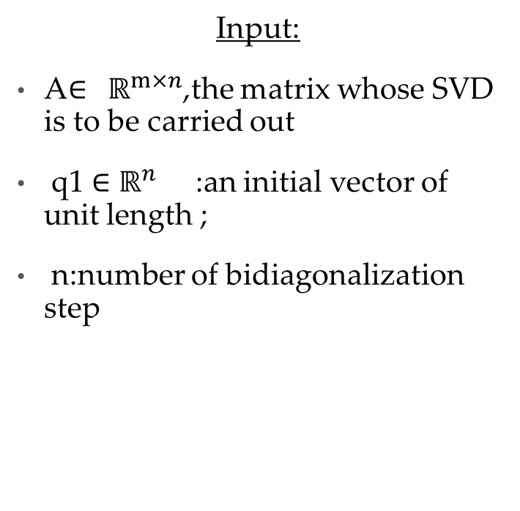
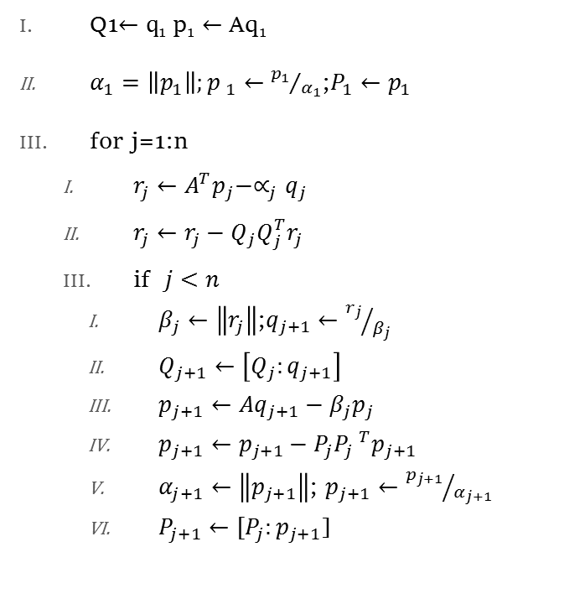
Partial Lanczos Bidiagonalization:Algorithm
Input:
A$∈$ $ℝ^{m×n}$,the matrix whose SVD is to be carried out
q1 $∈$ $ℝ^{n}$ :an initial vector of unit length ;
n:number of bidiagonalization step
Q1$←q$₁ p₁ $←$ Aq₁
$α_{1}=\left\|p_{1}\right\|;p _{1}←{p_{1}}/{α_{1}}$;$P_{1}←p_{1}$
for j=1:n
$r_{j}←A^{T}p_{j}−∝_{j}q_{j}$
$r_{j}←r_{j}−Q_{j}Q_{j}^{T}r_{j}$
if $j<n$
$β_{j}←\left\|r_{j}\right\|$;$q_{j+1}←{r_{j}}/{β_{j}}$
$Q_{j+1}←\left[Q_{j}:q_{j+1}\right]$
$p_{j+1}←Aq_{j+1}−β_{j}p_{j}$
$p_{j+1}←p_{j+1}−P_{j}P_{j} ^{T}p_{j+1}$
$α_{j+1}←\left\|p_{j+1}\right\|$; $p_{j+1}←{p_{j+1}}/{α_{j+1}}$
$P_{j+1}←[P_{j}:p_{j+1}$]

